Slide 1
Loan Default Predictions
Group members:
1.Kevin Thairu
2.Victor Njagi
3.Stella Njeru
4.Maureen Mureithi
5.Shadrack Kibet

Slide 2
Competition Problem:
This challenge was designed by Data Science Nigeria specifically for the DSN Bootcamp 2018. The objective was to predict if a loan was good or bad, i.e. accurately predict binary outcome variable, where Good is 1 and Bad is 0.
There are three set of data:
Demographic data: Basically describes
Performance data:
Previous loans data:

Slide 3
Descriptive Statistics

Slide 5
Predictive Model
Three models were used is this project:
  Random Forest Classifier
  Gradient Boosting Classifier
  Gaussian NB
  XG Boost Classifier

Slide 6
F1 & Precision Comparison
 |  | RF Classifier | GB Classifier | Gaussian NB | XGB Classifier
Precision | 1 | 0.89 | 0.96 | 0.83 | 0.95
 | 0 | 0.28 | 0.20 | 0.35 | 0.19
Recall | 1 | 0.82 | 0.82 | 0.83 | 0.82
 | 0 | 0.41 | 0.55 | 0.35 | 0.51
Where
  1 is Good Loan
  0 is Bad Loan

Slide 7
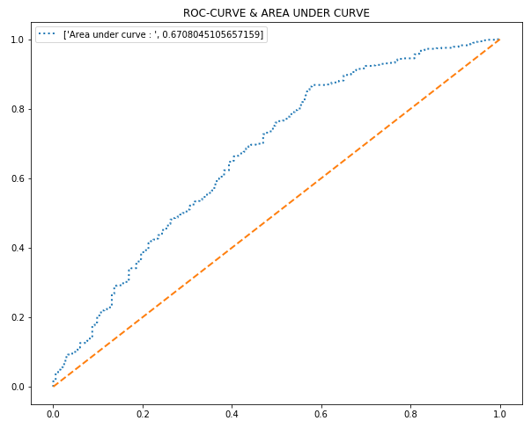
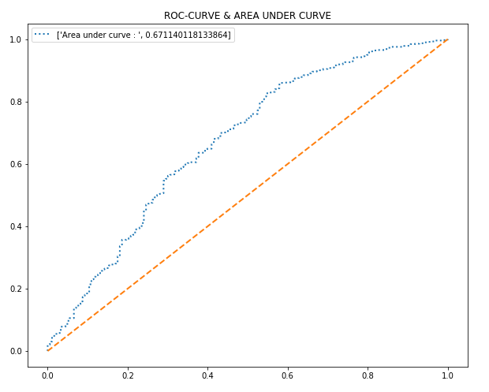
Results and Findings (ROC Curves)
XGB
GB

Slide 8
Recommendations

Slide 9
Limitations and Future work

Slide 10
Thak You

